Slide 1

Build Intelligent Applications with JavaScript: Integrating RAG, Azure OpenAI, and LangChain.js
Speaker Name
Role
@Username
Notes:
Introduction

Slide 2

RAG (Retrieval-Augmented-Generation)
Notes:
Well, first of all, it's extremely important that you understand this acronym: RAG! Has anyone here heard of it? (wait for the audience to respond) No problem! Let's understand it a bit here!
Retrieval Augmented Generation

Slide 3
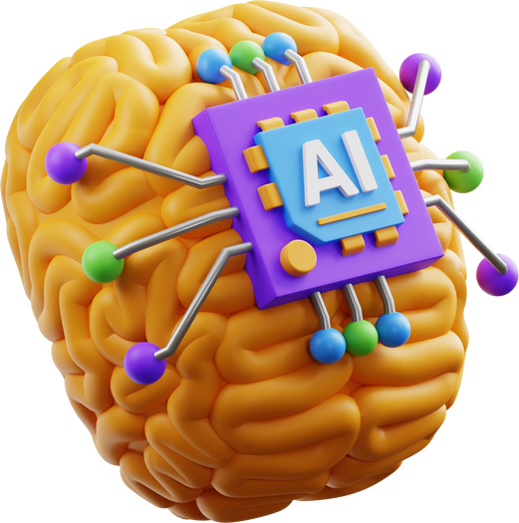
What is RAG?
Integrates external information retrieval
Significantly improving the accuracy and relevance of responses
Exclusively on content relevant to the company
Able to understand and process these specific types of content
Notes:
Retrieval Augmented Generation is an architecture that integrates the retrieval of external information into the process of generating responses by Large Language Models (LLMs).
What does it do? It will search a given database in addition to its pre-trained knowledge base, thus significantly improving the accuracy and relevance of the answers generated.
The RAG architecture, when applied in the business context, offers a method for focusing generative artificial intelligence (AI) exclusively on content that is relevant to the company. This means that AI can be targeted to work with specific information, such as documents, vectorized images and other types of business data. For this to work, it is essential to have AI models that are able to understand and process these specific types of content.
Put simply, RAG architecture allows companies to use AI to analyze and generate information from their specific data, such as texts and images related to their business, in a controlled and targeted way.

Slide 4
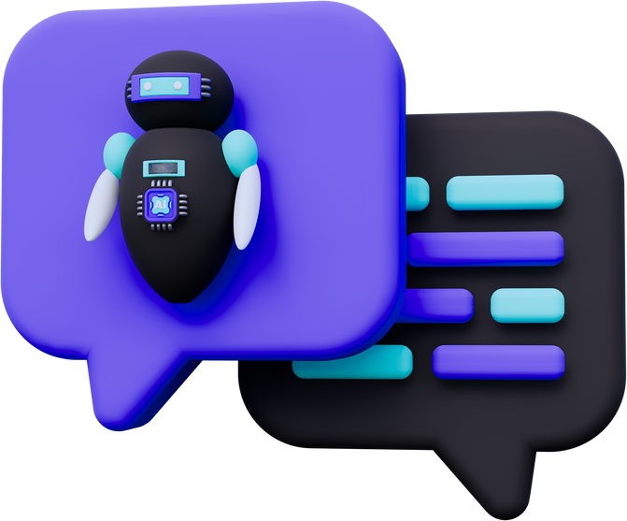
Summarizing...
"The RAG architecture allows companies to use AI to analyze and generate information from their specific data, such as text and images related to their business, in a controlled and targeted way."
https://learn.microsoft.com/en-us/azure/search/retrieval-augmented-generation-overview
Notes:
Simply put, the RAG architecture allows companies to use AI to analyze and generate information from their specific data, such as text and images related to their business, in a controlled and targeted way.

Slide 5
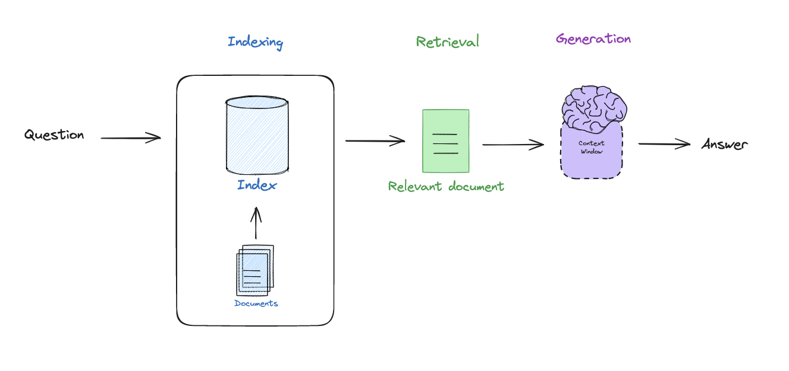
RAG Architecture
https://docs.google.com/presentation/d/1C9IaAwHoWcc4RSTqo-pCoN3h0nCgqV2JEYZUJunv_9Q/edit#slide=id.g26685277936_0_284
Notes:
Here we have a standard RAG architecture that should be implemented following this flow, which should contain:
Indexing: The indexing process organizes data in a vector database in a way that makes it easily searchable. This is a critical step because it sets the stage for RAG to quickly access relevant information when responding to a query. Mechanism: starts with the collection of documents, which are divided into smaller pieces by a splitter. Each piece of text is transformed into an embedding vector by complex algorithms. These vectors are stored in the database, allowing for efficient retrieval of similar information.
Retrieval (Retrieval): Uses vector similarity techniques to find more relevant documents or passages to answer a query. Mechanism: Sparse vector representations: These use keyword searches and are efficient, but may struggle with synonyms and semantic nuances. Dense vector embeddings: Employ language models to encode queries and passages into dense vectors, which are stored in vector databases and allow retrieval based on semantic similarity. Hybrid search: Combines keyword and vector search techniques to leverage the strengths of both and improve the quality of results.
Generation: With the most relevant passages retrieved, the generator's task is to produce a final response by synthesizing and expressing that information in natural language. Engine: The generator, usually a model such as GPT, BART, or T5, utilizes both the query and the relevant documents identified by the retriever to generate its response.
RAG é um tema extremamente importante e extensivo demais. Porém, se você aqui na audiência decidir desenvolver uma aplicação seguindo esse modelo, posso fornecer depois materiais e vídeos sobre o assunto!
Falando em aplicação....

Slide 6
LangChain.js
Notes:
Agora, vamos falar um pouco mais sobre o LangChain.js!
Alguém aqui já ouviu falar sobre o LangChain.js? E, para que serve?

Slide 7
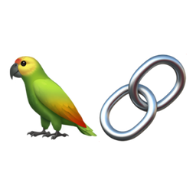
What is LangChain.js?
Modelos de Linguagem Grande (LLM)
Framework
Connect languages to context sources
Relying on a language model to reason
JavaScript and Python support
https://www.langchain.com/
Notes:
LangChain.js is a framework for developing applications powered by language models. It enables applications that:
Are context-aware : connect a language model to sources of context (prompt instructions, few-word examples, content to base their response on, etc.).
Reason: rely on a language model to reason (about how to respond based on the context provided, what actions to take, etc.)
The main value propositions of LangChain packages are:
1. Components: combinable tools and integrations for working with language models. The components are modular and easy to use, whether you are using the rest of the LangChain framework or not.
2. Ready-to-use chains: integrated assemblies of components to perform higher-level tasks. Ready-to-use chains make it easy to get started. The components make it easy to customize existing chains and build new ones.
I recommend you take a look at the framework's official website!
Translated with DeepL.com (free version)

Slide 8

Demo -
Serverless AI Chat with RAG and using LangChain.js
Notes:
Let's look at an example of an application that is making use of this architecture!
https://github.com/Azure-Samples/serverless-chat-langchainjs

Slide 9
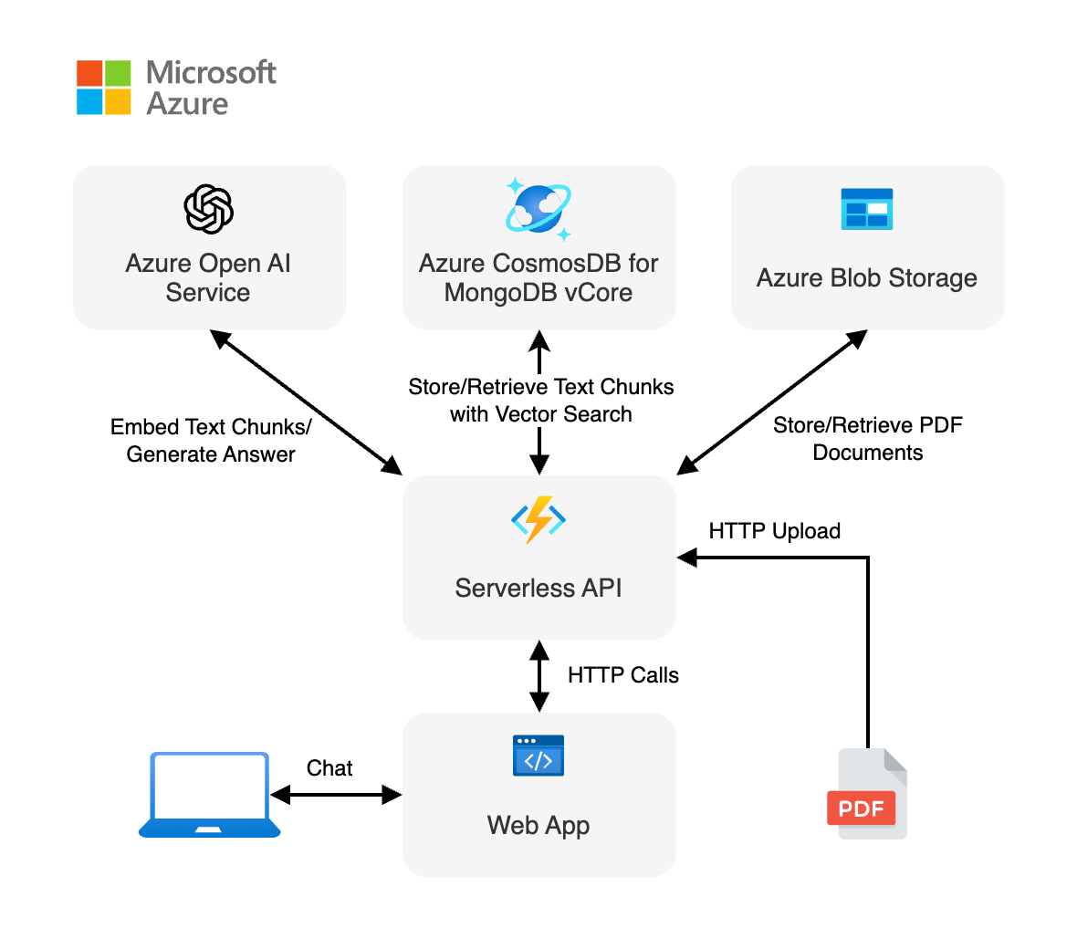
Before we show you a demo...
https://github.com/Azure-Samples/azure-search-openai-javascript
Notes:
Before I show you the demo, just to show you the architecture of this project!
Note that it follows the same RAG pattern (where we have an indexer, retriever and a generation)
In this case, we're using a PDF file. This PDF contains data from a fictitious company called: Contoso Real Estate. What do we use for this project?
Azure OpenAI Service
Azure CosmosDB for MongoDB vCore for vector search
Azure Blob Storage
Azure Functions (Serverless API)
Web App we used Lit
TypeScript as the main language
Good.... Let's get to the demo now!
Translated with DeepL.com (free version)

Slide 10

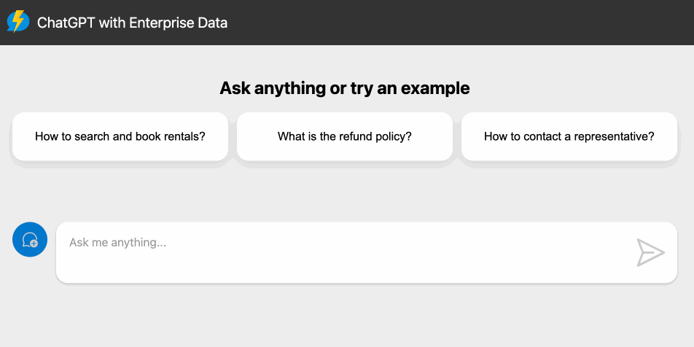
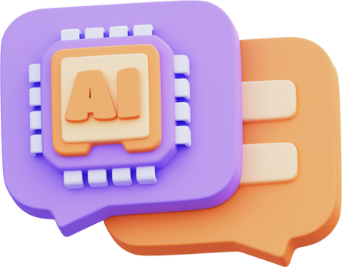
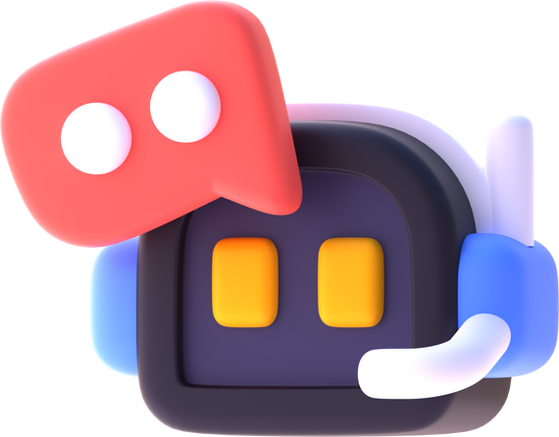
Go to the repository and give⭐
https://github.com/Azure-Samples/serverless-chat-langchainjs

Slide 11
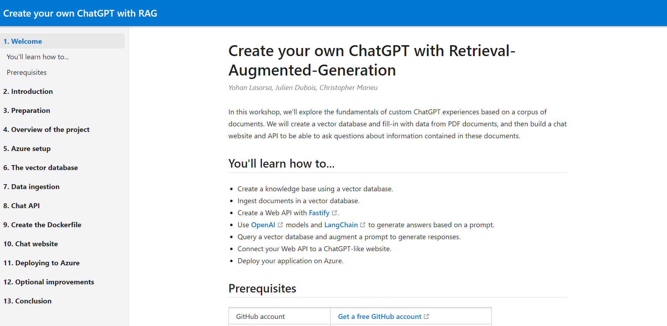
Access the workshop and share!⭐
https://aka.ms/ws/openai-rag

Slide 12







</>
Let's keep in touch?!
github.com/username
username
username
username
@ username
Source Code on GitHub
Notes:
So... If you want keep in touch with me, please let’s connect! I am in several social medias, specially on Twitter and making some live coding on Twitch.
So... If you want to know more updates about some updates about technology and keep in touch with me, follow me on Twitter.
And below, has a link to the GitHub repository with the demos and some importante resources and links!

Slide 13
Thank you very much!

